Slide 1
Connecting College to Career with State Government Data

Slide 2
Agenda
Overview of INK
Source Data & Partner Agencies
Security & Protecting PII
Data Request Process
Potential Uses for Career Centers
2

Slide 3
Why use Data in Career Services?
Provide evidence for current programs/services and new ideas
Informed decision making
New insights
The Future of Career Services is Now
3

Slide 4
Service
“Collecting data should seek to provide value back to the people on whom data are being collected”
-National PTA
4

Slide 5
History
Where did we start…
Indiana Workforce Intelligence System (IWIS) 2007-14
IBRC, DWD, CHE, IDOE
Where are we...
Indiana Network of Knowledge (INK) 2014-Present
FSSA, IDOE, CHE, DWD
Where are we going…
Merger with the Management Performance Hub (MPH)
All while maintaining compliance with all state and federal privacy laws
5

Slide 6
Purpose
INK Vision: Become the trusted source for Hoosier education and workforce information.
INK Mission: Provide access to accurate, secure, and timely data to help Hoosiers make informed education and workforce decisions.
6

Slide 7
Staffing
Jeff Hudnall, Executive Director
Carol Torres, Data Analyst
San Saravanan, Data Analyst
Lora Walker, Program Director
Matt Hetzel, Communications Analyst
Santhosh Pinninti, ETL Developer
7

Slide 8
Data Governance
Governance Committee
Executive Lead Team
Research Advisory Group
Technical Advisory Group
Data Request Team
Management Performance Hub (MPH)
8

Slide 9
Future State
Integrate more data sets from current and future partners
Streamline the request process
Data self-service options
Data literacy
3 P’s (Predictors, Progress, & Pathways)
9

Slide 10
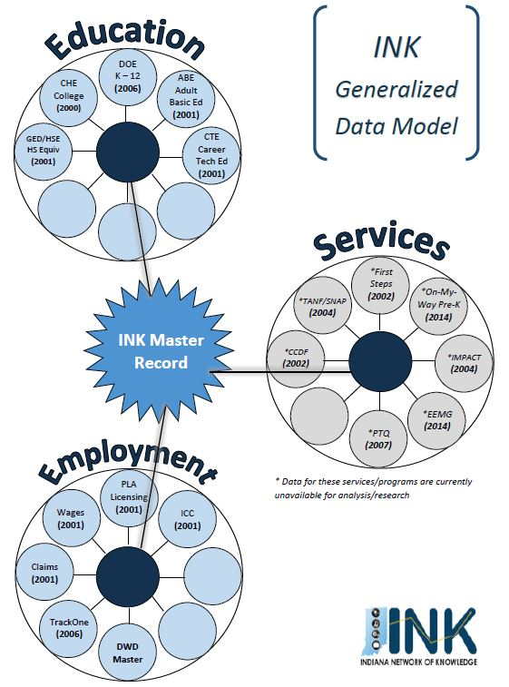
10

Slide 11
Source Data & Partner Agencies
IN Department of Education (IDOE):
K-12 Data
Students
Attendance
Graduation
Schools & Corporations
Assessments
11

Slide 12
Source Data & Partner Agencies
Commission for Higher Education (CHE):
Post-Secondary Data
Students
Post-Secondary Institutions
Programs of Study and Degrees
12

Slide 13
Source Data & Partner Agencies
Department of Workforce Development (DWD):
Workforce and DWD Program Data
Employees & Wages
IMPACT
GED/HSE, ABE and CTE
Professional Licensing
Unemployment
13

Slide 14
Source Data & Partner Agencies
Family and Social Services Administration (FSSA):
Assistance Programs and Early Childhood Data
TANF & SNAP
CCDF
First Steps
On My Way Pre-K
Early Education Matching Grant (EEMG)
Paths to Quality (PTQ)
14

Slide 15
Matching Records
Records compressed into PII properties
Name, DOB, gender, race/ethnicity, SSN (or last 4), student ID or STN
Intra-agency, then inter-agency comparison
‘Master’ file compiled
Evaluated for approximate similarity, grouped and assigned Global ID; master file updated
Scored and graded; low-scoring records de-grouped
INK tables updated with Global ID
15

Slide 16
Security & Protecting PII
Multiple levels of security
Secure accounts and passwords
Physical location of data
Only ETL team can transfer data and interact with the data
Extremely restricted access to authorized users only
Data are aggregated; record-level data are de-identified
DSAs required; publications subject to review
16

Slide 17
Data Request Process
Data requests emailed to: DataRequest@ink.in.gov
Meet with INK data analyst to complete data request form
Data Request Team (DRT) review/approval
A key factor they review is purpose and alignment with buckets on the next slide/FERPA
INK data analyst defines requirements (data elements, calculations, limitations/ranges on specific fields, etc.)
Final DRT review/approval
DSA executed
INK ETL team compiles data and sends to requestor
17

Slide 18
Data Requests
Research Buckets: Education Readiness, Career Readiness, and Program Effectiveness
Requests should be cross agency; contain data from at least two of the agencies we work with.
Graduation outcomes for DCS children
Dropout outcomes evaluation
Wage comparison of HS dropouts vs HS graduates
ISU Meis Center Evaluation
Agency Reports: ROI, College Readiness
18

Slide 19
How Can Career Centers Use This?
Evaluating ROI for the work you do
Specific use cases:
CC involvement outcomes evaluation
Program evaluation
Internship outcomes
Supplement to FD, work with other SLDS
Connecting with “Donut” States: IL, MI, OH, and KY
19

Slide 20
Next Steps
Collaborate and coordinate with others on campus
Identify people who can do an analysis & organize the data
Students, Institutional Research, Faculty
Reviews resources that already exist
ROI
Stats Indiana
Hoosiers by the Numbers
20

Slide 21
Big Data
“ Big Data is NOT About the Data.”
-Gary King
21

Slide 22
Questions?
www.in.gov/ink
Matt Hetzel: mhetzel@ink.in.gov
22

